Slide 1

Effectiveness of the database solution
Evaluating the effectiveness of the database solution in relation to user and system requirements, and improvements.

Slide 2

What are the user & system requirements?

Slide 3

User requirements
All users of the system must fulfil all user requirements by satisfying the following criteria. Users have been categorized to admins, consumers and supporters.
The following criteria is applicable to all users:
Have a history of decent exposure to other well-known application software.
Must strictly remain within their scope of action.
Have a primary sense of reporting any and all strange behaviors to the school’s IT staff.
Must obey all school practices.
Notes:
Users have been categorized to 3 groups, depending on the role they have to perform in order to extract the best of the system. Namely, Admins, Consumers and Supporters.
The roles and abilities of each user type:
Admin users: have read/write permissions, can change passwords of consumers and other admins, can create consumer accounts, can backup & restore the database and can completely erase all data within the database.
Consumer users: have read/write permissions for all forms across the system.
Support users: do not interact with the system at all. They exist in order to ensure that the system functions well and to serve the purpose of reporting management level or the IT staff when an error of sufficient magnitude has occurred.

Slide 4

System requirements
For the trinity music school database solution to run in it’s optimum behaviour the following criteria must be met.
This database solution is only compatible with Windows systems.
Microsoft Windows 7 or higher.
Intel i3 1.4 GHz 7th gen.
At least 512 MB of RAM
10 MB of disk space upon initial install, with insertion of data, required disk space increases.
Notes:
The database solution was built on a version of SQL server compatible with on Windows, as such it will not run on operating systems like MacOS, GNU/Linux, FreeBSD etc.
By minimum 512 MB of RAM is required, in order for visualization atleast 16 MB of VRAM is also required.
The processor could go below the specified generation and clock speed but performance will degrade appropriately.

Slide 5
Expected system requirements
These requirements are the ones that Trinity Music School expect the system to have and have been implemented on the solution.

Slide 6

Primary system requirements
These requirements were the first to be implemented to the solution and have been done so satisfactorily.
Trinity expects and have been provided with a database that can keep records of:
Classes.
Teachers that teach on a class.
Students that participate in a class.
Instruments rented for a particular class.
Notes:
Users have been categorized to 3 groups, depending on the role they have to perform in order to extract the best of the system. Namely, Admins, Consumers and Supporters.
The roles and abilities of each user type:
Admin users: have read/write permissions, can change passwords of consumers and other admins, can create consumer accounts, can backup & restore the database and can completely erase all data within the database.
Consumer users: have read/write permissions for all forms across the system.
Support users: do not interact with the system at all. They exist in order to ensure that the system functions well and to serve the purpose of reporting management level or the IT staff when an error of sufficient magnitude has occurred.

Slide 7
Secondary system requirements
These requirements were implemented alongside the tertiary requirements upon careful inspection
Trinity expects and have been provided with a database that has the following tables:
Class table must contain class code, instrument taught, teachers, number of instruments rented, start/end data and timing attributes.
Instrument table must contain instrument type code, instrument name, supplier company and contact number attributes.
Student table must contain student name, student type and class attended attributes.
Notes:
Users have been categorized to 3 groups, depending on the role they have to perform in order to extract the best of the system. Namely, Admins, Consumers and Supporters.
The roles and abilities of each user type:
Admin users: have read/write permissions, can change passwords of consumers and other admins, can create consumer accounts, can backup & restore the database and can completely erase all data within the database.
Consumer users: have read/write permissions for all forms across the system.
Support users: do not interact with the system at all. They exist in order to ensure that the system functions well and to serve the purpose of reporting management level or the IT staff when an error of sufficient magnitude has occurred.

Slide 8
Tertiary system requirements
Trinity expects and have been provided with following enforcements:
Enforce each type of musical instrument being supplied by only one company.
Enforce rental formula as “NumberOfInstruments * Period”.
Enforce one class can have many students.
Enforce one student can have many classes.
Enforce student classification of types “Full_Time”, “Part_Time” and “Part_Time_Evening”.
Enforce one teacher can have many classes.
Enforce one class can have many teachers.
These requirements were the final features implemented to the solution and were the most challenging to do so as they are primarily logic-based.
Notes:
Users have been categorized to 3 groups, depending on the role they have to perform in order to extract the best of the system. Namely, Admins, Consumers and Supporters.
The roles and abilities of each user type:
Admin users: have read/write permissions, can change passwords of consumers and other admins, can create consumer accounts, can backup & restore the database and can completely erase all data within the database.
Consumer users: have read/write permissions for all forms across the system.
Support users: do not interact with the system at all. They exist in order to ensure that the system functions well and to serve the purpose of reporting management level or the IT staff when an error of sufficient magnitude has occurred.

Slide 9
Evidence of requirement fulfilment
Class, student, teacher and instrument tables will be visualized to prove fulfilment.
NOTE: Tertiary requirements are logic-based and can not be visualized through tables, an ERD is provided instead.

Slide 10
Class Table
Fulfils 1st primary requirement and 3rd secondary requirement.
c_id | c_start | c_end | c_type
1111 | 2018-10-18 08:00:00.000 | 2018-10-18 13:34:09.000 | FULL_TIME
1112 | 2018-10-19 08:15:00.000 | 2018-10-18 14:00:00.000 | PART_TIME
1113 | 2018-10-20 09:30:00.000 | 2018-10-18 14:11:00.000 | PART_TIME_EVENING

Slide 11
Student Table
Fulfils 3rd primary requirement and secondary requirement.
s_id | i_id | s_name | s_type | s_regist_date | s_dob | s_contact_no
1 | 103 | Saline Man | FULL_TIME | 2018-10-18 00:00:00.000 | 2000-09-28 00:00:00.000 | 076 1234567
2 | 103 | Saline Woman | PART_TIME | 2018-10-12 00:00:00.000 | 2000-01-01 00:00:00.000 | 077 1234567
3 | 103 | Orange Man | PART_TIME_EVENING | 2018-10-13 00:00:00.000 | 2000-04-01 00:00:00.000 | 078 1234567
4 | 102 | Orange Woman | PART_TIME_EVENING | 2018-07-15 00:00:00.000 | 2000-06-02 00:00:00.000 | 079 1234567
5 | 102 | Banana Man | FULL_TIME | 2018-10-18 00:00:00.000 | 2000-05-16 00:00:00.000 | 032 1234567

Slide 12
Teacher Table
Fulfils 3rd primary requirement.
t_id | t_name | t_contact_no
10001 | Dumbledore McField | 079 123467

Slide 13
Instrument Table
Fulfils 2nd primary requirement and secondary requirement.
i_id | supp_id | i_name | i_quantity | i_rental
103 | 100 | Violin | 13 | 20398.00
102 | 100 | Guitar | 10 | 15201.00

Slide 14
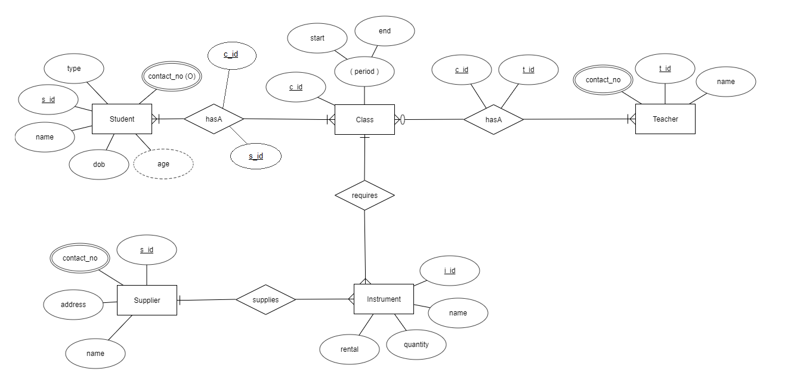
Evidence to prove tertiary requirements.
Notes:
The 5 entities and their properties:
Student – Is in a many-to-many mandatory participation relationship named “hasA” with entity Class.
Class – Is in a many-to-many mandatory participation relationship named “hasA” with entity Student, is a many-to-many optional participation relationship named “hasA” with entity Teacher and Is in a one-to-many relationship named “requires” with entity Instrument.
Teacher – Is in a many-to-many mandatory participation relationship named “hasA” with entity Class.
Instrument – Is in a one-to-many relationship named “requires” with entity Class and Is in a one-to- many relationship named “supplies” with entity Supplier.
Supplier – Is in a one-to-many relationship named “supplies” with entity Supplier.

Slide 15
Why evidence to prove effectiveness?
As the database solution is not simplistic, the most rational way to demonstrate how effectively the user and system requirements have been captured is to first explain the user and system requirements and then provide evidence that the solution has fulfilled these requirements through implementation.
This allows users of both technical and non-technical fields to grasp how powerful this solution is.
Notes:
The database solution was built on a version of SQL server compatible with on Windows, as such it will not run on operating systems like MacOS, GNU/Linux, FreeBSD etc.
By minimum 512 MB of RAM is required, in order for visualization atleast 16 MB of VRAM is also required.
The processor could go below the specified generation and clock speed but performance will degrade appropriately.

Slide 16
Possible future improvements

Slide 17
Encrypt Data while performing CRUD.
Doing so will minimize security issues and keep users that have accessed the database without the authority to do so from using the data elsewhere or cause any financial damage to Trinity.
Recommendation: AES 256 encryption algorithm. It is easy to implement and difficult to break so security is ensured while having maximum performance
Notes:
The database solution was built on a version of SQL server compatible with on Windows, as such it will not run on operating systems like MacOS, GNU/Linux, FreeBSD etc.
By minimum 512 MB of RAM is required, in order for visualization atleast 16 MB of VRAM is also required.
The processor could go below the specified generation and clock speed but performance will degrade appropriately.

Slide 18
Use Reporting services to visualize data
This will allow admins to extract data, visualize them in reports and help management departments to make decisions about Trinity’s future.
Recommendation: SAP Crystal Reports Reporting service, at a cheap cost dynamic and extremely informative reports can be created.
Notes:
The database solution was built on a version of SQL server compatible with on Windows, as such it will not run on operating systems like MacOS, GNU/Linux, FreeBSD etc.
By minimum 512 MB of RAM is required, in order for visualization atleast 16 MB of VRAM is also required.
The processor could go below the specified generation and clock speed but performance will degrade appropriately.

Slide 19
Host the database separate from the application and use a REST API to query data
This will not only boost security and ensure minimal system failure but also allow centralization of the database, so companies all over the world can interact with Trinity’s API to request data that could lead to expanding Trinity’s wings.
Recommendation: Cloud services or specialized database server hosting. For a very low price, centralization, security and 24/7 support is established. Or else locally host a database server.
Notes:
The database solution was built on a version of SQL server compatible with on Windows, as such it will not run on operating systems like MacOS, GNU/Linux, FreeBSD etc.
By minimum 512 MB of RAM is required, in order for visualization atleast 16 MB of VRAM is also required.
The processor could go below the specified generation and clock speed but performance will degrade appropriately.

Slide 20
Navigate from SQL to NoSQL
Trinity’s data schemas are yet too immature and very unstructured. A single student or teacher may have properties or data unique to him/her or classes may have properties that might have specialized attributes to it.
In cases of immature data schemas and when a company is moving from traditional storage to databases, NoSQL database solutions are ideal.
Recommendation: MongoDB, a robust, server-based and highly performant NoSQL DBMS that is popular world-wide and is used to solve the above mentioned problems.
Notes:
The database solution was built on a version of SQL server compatible with on Windows, as such it will not run on operating systems like MacOS, GNU/Linux, FreeBSD etc.
By minimum 512 MB of RAM is required, in order for visualization atleast 16 MB of VRAM is also required.
The processor could go below the specified generation and clock speed but performance will degrade appropriately.

Slide 21




The End
Shenesh Perera
+94 0761964698
sheneshperera23@gmail.com

